Slide 1
PartyGuard Web Application
End term presentation
Team 52 - PartyGuard Web Application-PartyFreaks
1

Slide 2
Outline
Team Members
Team Members Responsibilities
Client Information
PartyGuard Web Application Description
Modules and functionalities
Technology Stack
Demo
Challenges
Future Tasks
Lessons Learnt
Team 52 - PartyGuard Web Application
2

Slide 3
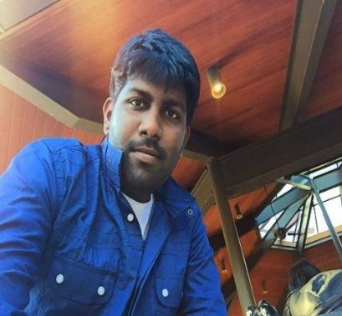
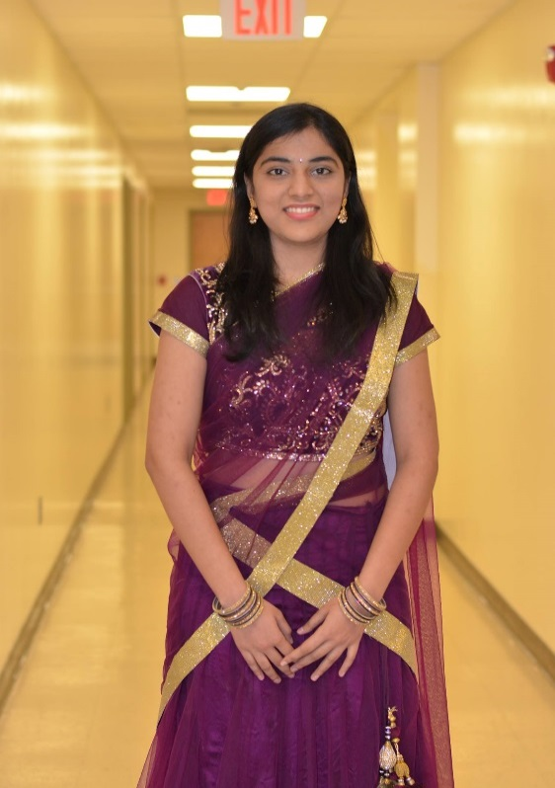
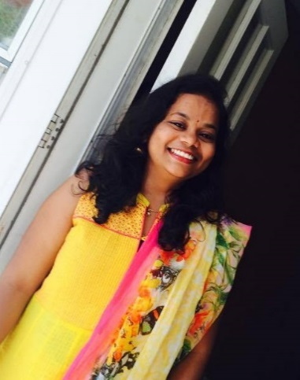
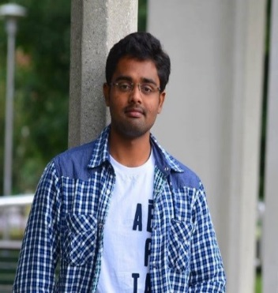
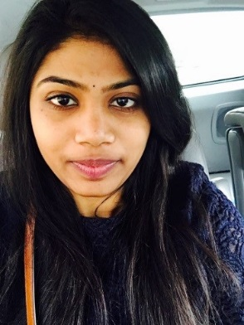
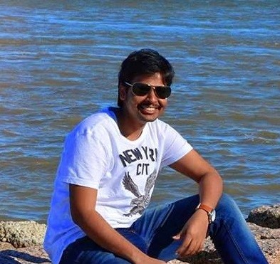
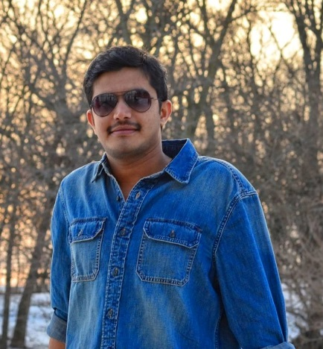
Team Members
Abishai
Nihitha
Sindhuja
Srichaitanya
Spandana
Lokesh
Gopinadh
3
Team 52 - PartyGuard Web Application

Slide 4
Team Member Responsibilities
Role | Team Member
Primary Contact | Prem Abishai Parise
Client Management | Nihitha Reddy Bhimireddy
Requirements Management | Lokesh Reddy Pothapu
Data Management | Srichaitanya Peddinti
Issues Management | Sindhuja Pannala
Quality and Testing Management | Spandana Velaga
Communications and Documentation Management | Gopinadh Cherupally
Team 52 - PartyGuard Web Application
4

Slide 5

Client Information
Client mission:
To develop a web application for users
which will help them to prevent sexual
assaults and accidents happening within
Greek life specifically fraternity houses.
Jacob C Stansbury
S516098@mail.nwmissouri.edu
Team 52 - PartyGuard Web Application
5

Slide 6
PartyGuard-Web Application
It is a web application which will be accessible to three kinds of users (i,e Master user, Host user, Guard user and Basic user)
This application will offer service to subscribed fraternity houses only
Then the subscribed fraternity can use PartyGuard in their social gatherings to create a safe environment
This PartyGuard web application works in coordination with Android application and iOS application
Team 52 - PartyGuard Web Application
6

Slide 7
Modules
Admin User
Admin
Dashboard.html
Dashboard.js
AddCustomer.html
AddCustomer.js
Module
View
Controller
ViewCustomers.html
Addack.html
Addack.js
ViewCustomers.js
Team 52 - PartyGuard Web Application
7

Slide 8
Modules(Contd..)
Host User
Host
HostProfile.html
HostProfile.js
Events.html
Events.js
Module
View
Controller
HouseLocation.html
EditEvents.html
EditEvents.js
HouseLocation.js
Members.html
Members.js
NewCustomer.html
NewCustomer.js
8
Team 52 - PartyGuard Web Application

Slide 9
Modules(Contd..)
Guard User
Guard
GuardProfile.html
GuardProfile.js
GuardRegistration.html
GuardRegistration.js
Module
View
Controller
Team 52 - PartyGuard Web Application
9

Slide 10
Modules(Contd..)
Basic User
Basic
BasicProfile.html
BasicProfile.js
Module
View
Controller
Team 52 - PartyGuard Web Application
10

Slide 11







Tools and Technologies Stack
Web Technologies
Team 52 - PartyGuard Web Application
11

Slide 12



Tools and Technologies Stack (Contd..)
Tools
Team 52 - PartyGuard Web Application
12

Slide 13


Tools and Technologies Stack (Contd..)
Version Control
Database
Team 52 - PartyGuard Web Application
13

Slide 14


Tools and Technologies Stack (Contd..)
Deployment
14
Team 52 - PartyGuard Web Application

Slide 15
What has been done?
Master User
Master user login
Adding customer/fraternity
View customers
Provided validations
Team 52 - PartyGuard Web Application
15

Slide 16
What has been done?(Contd..)
Host User
Host user login (Using credentials given by admin)
Create an event
Assign guards to the created event (call back function)
View members(guards)
Team 52 - PartyGuard Web Application
16

Slide 17
What has been done?(Contd..)
Guard User and Basic User
Guard user login
Edit guard user profile
Change password
Basic user login
Edit basic user profile
Team 52 - PartyGuard Web Application
17

Slide 18
What’s new?
Master User
Email functionality in Customer acknowledgement page
Admin dashboard updates dynamically
Team 52 - PartyGuard Web Application
18

Slide 19
What’s new? (Contd..)
Host User
Integrated all the APIs required for host user functionalities.
The host user can edit/delete the created events
The created events are updated dynamically in View events page
Guards can be assigned to the created events
Team 52 - PartyGuard Web Application
19

Slide 20
What’s new?(Contd..)
Guard User and Basic User
Guard user registration
Basic user change password
Team 52 - PartyGuard Web Application
20

Slide 21
Demo
https://partyguard.herokuapp.com/
Team 52 - PartyGuard Web Application
21

Slide 22
Challenges
Email functionality is successful in local host but due to security issues it is not supported where the application is
hosted
Team 52 - PartyGuard Web Application
22

Slide 23
Future Tasks
Host the site in Azure to make it available to everyone
Installing project on client’s machine and making sure that
it works properly
Provide production support to make application stable
Wrapping up and loading contents of team repository as DVD
Team 52 - PartyGuard Web Application
23

Slide 24
Lessons Learnt
Learned Nodejs, AngularJs, Expressjs, Bootstrap, MDB
Learned how to use atom editor
Learned to deploy our web application in Heroku
Team collaboration
Team 52 - PartyGuard Web Application
24

Slide 25
PartyGuard iOS App
Team 21 - BASH GUARDIANS
25

Slide 26
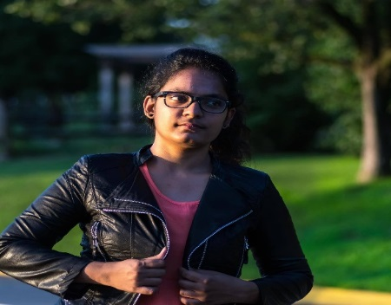
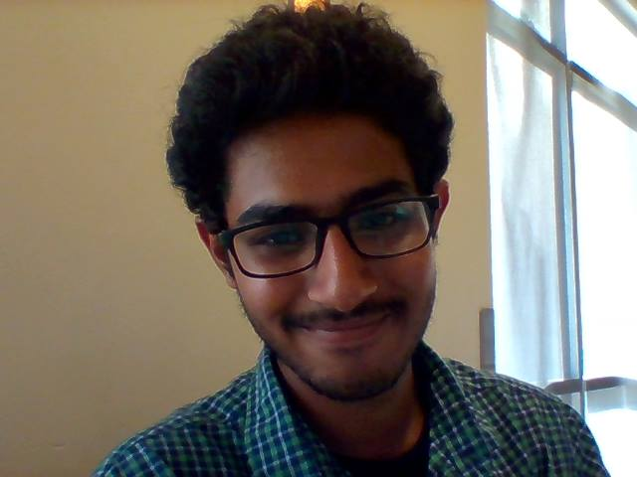
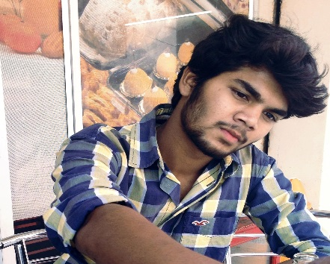
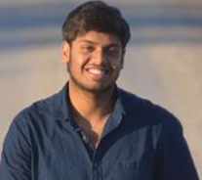
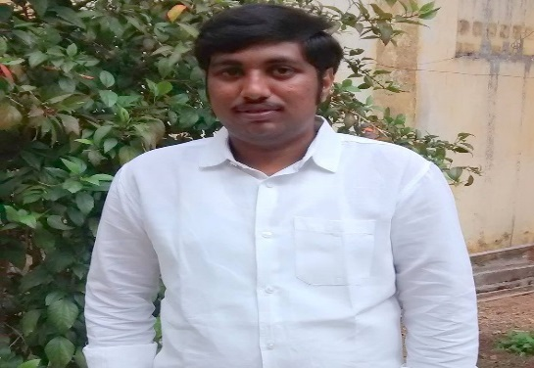
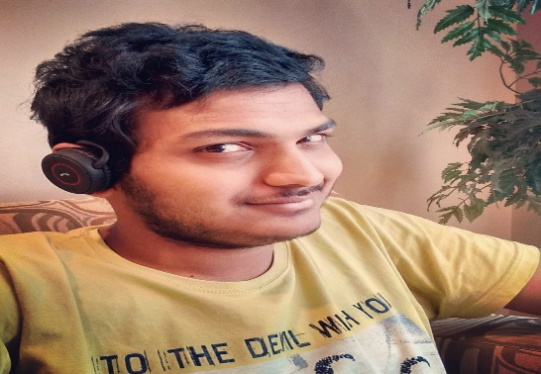
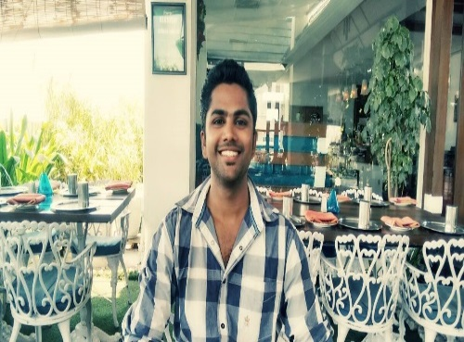
Team Members
Sai Spandana
Nandeesh
Vinod Somu
Pushpak
Sai Naveen
Sanjeev
Yashwanth
Team 21 – PartyGuard BashGuardians
26

Slide 27
Team Member Responsibilities
Role | Team Member
Primary Contact | Sai Spandana Chava
Client Management | Sanjeev Koneru
Requirements Management | Nandeesh Tankasala
Data Management | Naveen
Issues Management | Pushpak
Quality and Testing Management | Yashwanth Teja
Communications and Documentation Management | Vinod Somu
Team 21 – PartyGuard BashGuardians
27

Slide 28
Outline
Work completed
Work in progress
Work remaining
Challenges faced
Team collaboration
Demo
Team 21 – PartyGuard BashGuardians
28

Slide 29
Work completed
Core functionality for Basic, Host and Guard user
Integrated services for Basic user
Login, Register, User Info, Fraternity list, Issue raising
Integrated services for Host user
Login, PG Team Service, Alerts
Integrated services for Guard user
Login, Register, Alerts
Team 21 – PartyGuard BashGuardians
29

Slide 30
Work in progress
Integrate service of alert resolved notification
Client acceptance and cross team testing
User Documentation
30
Team 21 – PartyGuard BashGuardians

Slide 31
Work remaining
Image handling
App information screen
Team 21 – PartyGuard BashGuardians
31

Slide 32
Challenges faced during Development
Adding constraints
Integrating services
To resolve merge conflicts in bit bucket
Team 21 – PartyGuard BashGuardians
32

Slide 33
Team Collaboration
We have collaborated with web services team “Megatrons” to make
sure that PartyGuard iOS application works with no errors.
Team 21 – PartyGuard BashGuardians
33

Slide 34
PartyGuard Demo
Team 21 – PartyGuard BashGuardians
34

Slide 35
The Think Tank
PartyGuard Android App
End Term Presentation
35

Slide 36
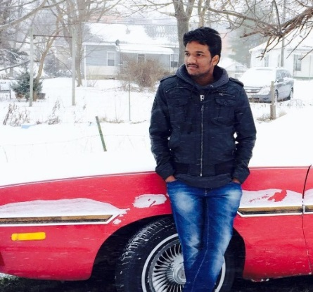
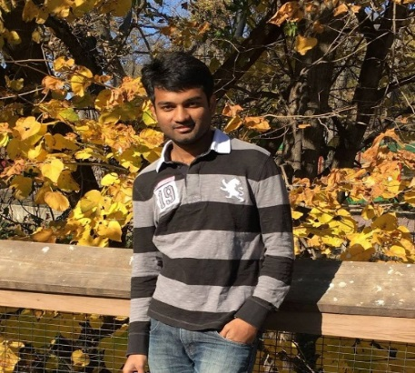
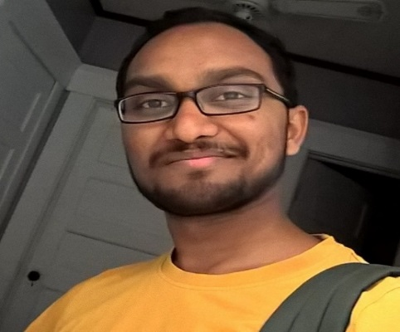
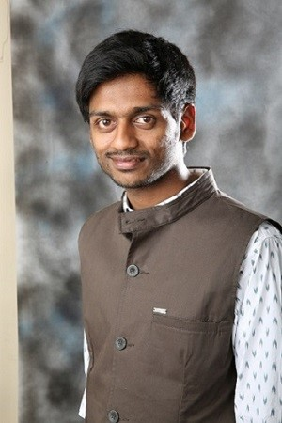
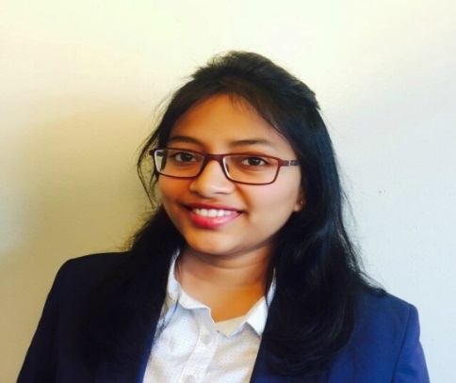
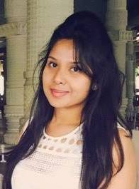
Team members
Arun Nadipudi
Nikhil Yerram
Santosh Boyina
Sreshtha Kolluru
Sharath Regonda
36
Sanjana Somisetty

Slide 37
Team Member Responsibilities
Role | Team Member
Primary Contact | Nikhil Yerram
Client Management | Nikhil Yerram
Requirements Management | Santosh Boyina
Data Management | Sanjana Somisetty
Issues Management | Sharath Regonda
Quality and Testing Management | Arun Nadipudi
Communications and Documentation Management | Sreshtha Kolluru
Team 42 – PartyGuard Android
37

Slide 38
Client Information
Name : Jacob Stansbury
Email : S516098@mail.nwmissouri.edu
Mission : To get an Android app for the safety of women at parties.
Team 42 – PartyGuard Android
38

Slide 39
Technologies
Android Studio – IDE used to develop application.
Java
BitBucket and SourceTree as version control tools.
EngageUAT as Testing tool.
Team 42 – PartyGuard Android
39

Slide 40
Work Done Previously
In the previous demo, we have showed the update version of
the user interface of our application.
We have shown the services of basic user registration and basic user login.
Team 42 – PartyGuard Android
40

Slide 41
Work Done from Previous Client Demo
In the past few weeks, we have done some of the changes to the user interface directed as per the client.
We have worked with the services team and successfully
integrated the services and also integrated with few more
services such as guard registration, guard login, host login and
getting the universities list.
Team 42 – PartyGuard Android
41

Slide 42
PartyGuard Demo
Team 42 – PartyGuard Android
42

Slide 43
Future Tasks
Write the code for remaining services and integrate.
Try to provide auto login for our application.
Achieve the core functionality features.
Team 42 – PartyGuard Android
43

Slide 44
Challenges Faced
Retrieving the alerts and displaying it on the Host/Guard side of the application.
Getting the list of universities from each available location.
44

Slide 45
PartyGuard iOS Application
Team54- PartyGuardiOS
45
ALLPPT.com _ Free PowerPoint Templates, Diagrams and Charts

Slide 46
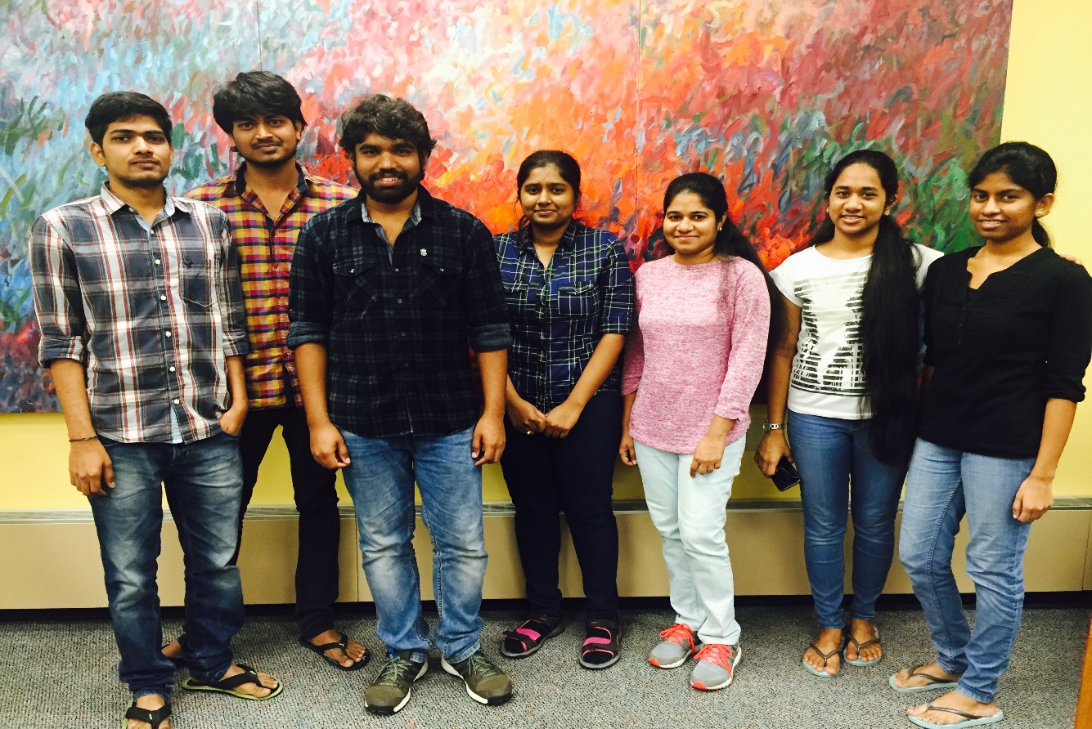
Team Members
Team54- PartyGuardiOS
46

Slide 47
Roles & Responsibilities
Role | Name
Primary contact | Satya Radha Addala
Client management | Bhavana Pilli
Requirements management | Sri Harsha Yadav Rachakunta
Data management | Harika Danala
Issues management | Harish Kola
Quality and testing management | Prasanth Butna
Communications and documentation management | Mounica Ramini
Team54- PartyGuardiOS
47

Slide 48
PartyGuard-iOS
Developing an iOS mobile application for users to prevent sexual assaults and accidents happening in fraternity houses.
Main goal of application is to protect women.
Girls who went to fraternity events can raise request for help using this free app in their mobiles.
Team54- PartyGuardiOS
48

Slide 49
Collaboration
We will be working closely with the PartyGuard Web Services team (Megatrons) throughout our project.
The Web Services team will be providing the API links and that data will be used in our mobile application.
Team54- PartyGuardiOS
49

Slide 50





Tools & Technologies used
Team54- PartyGuardiOS
50

Slide 51
Progress
Integrated basic user web services into the app provided by web services team.
Implemented call back functionality.
Basic User, Guard and Host Screens design is completed.
Tested Login, Registration, Forgot Password, Edit Profile functionalities.
Making appropriate changes when issues were raised.
Team54- PartyGuardiOS
51

Slide 52
Future Tasks
Integrate remaining services.
Handle push notification.
Test the remaining flows and also the whole application.
Resolve all the issues.
Team54- PartyGuardiOS
52

Slide 53
Challenges
Uncertain behavior of the web services.
Handling push notifications.
Team54- PartyGuardiOS
53

Slide 54
DEMO
Team54- PartyGuardiOS
54

Slide 55
PartyGuard Android App
-Android Nachos
55

Slide 56
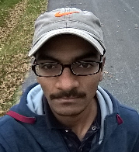
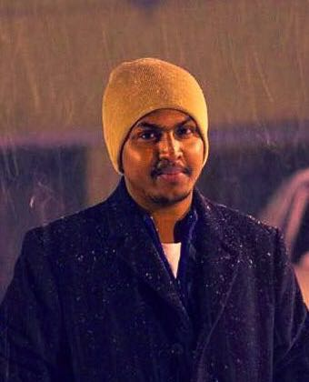
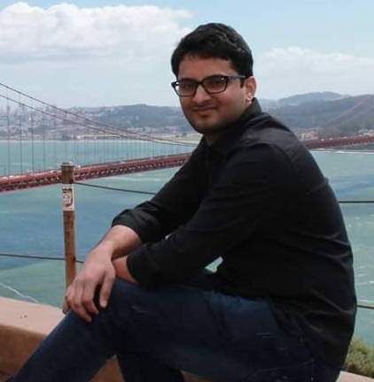
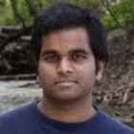
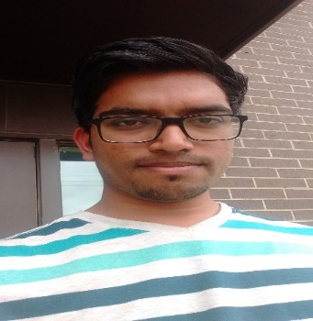
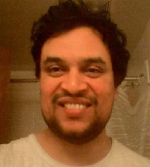
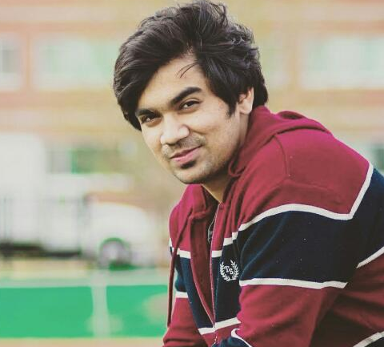
Team Members
Harish Yanala
Rakshith
Vinod Kumar
Seshu Kumar
Harish Yeddluri
Sridhar
Ashish Peruru
56
Team 41 – PartyGuard AndroidNachos

Slide 57
Team Member Responsibilities
Role | Team Member
Primary Contact | Rakshith Anand
Client Management | Vinod Kumar Kurma
Requirements Management | Seshu Kumar
Data Management | Sridhar Yerasi
Issues Management | Harish Yanala
Quality and Testing Management | Ashish Peruru
Communications and Documentation Management | Harish Yeddluri
57
Team 41 – PartyGuard AndroidNachos

Slide 58
Outline
What have we done?
What are we doing?
What needs to be done?
Challenges Faced
Lessons Learnt
58
Team 41 – PartyGuard AndroidNachos

Slide 59
What have we done?
We have completed integrating the following functionalities with services:
Profile screens with services for basic, guard and host users
Edit profile for the basic user
Refresh functionality for Alert list in Guard
PGTeam screen with services
Guard Availability(PG Team Toggle button) with services
Guard Alert List
59
Team 41 – PartyGuard AndroidNachos

Slide 60
What have we done?
We have completed integrating the following functionalities with services:
Host Alert List
Claim Alert List
Resolve Alerts
Guard Alert History
Resolved validation issues with Login Activity and Basic, Guard user Registration
60
Team 41 – PartyGuard AndroidNachos

Slide 61
What are we doing?
We are working on:
Integrate screens as and when services are ready
Unit testing for the developed screens
User Documentation, User manual and cross team testing
61
Team 41 – PartyGuard AndroidNachos

Slide 62
What needs to be done?
We need to work on:
Integrating the list of services for various users:
Basic User: 4
Host User: 3
Guard User: 3
Unit testing and Integration testing
Documentation
62
Team 41 – PartyGuard AndroidNachos

Slide 63
Challenges Faced
The following are the challenges that we faced while working on the project:
Services Integration time frame
Data availability in the existing services
Resolving merge conflicts
Developing custom controls
Collaborating with different teams
63
Team 41 – PartyGuard AndroidNachos

Slide 64
Lessons Learnt
The following are the Lessons that we learnt while working on the project:
Utilizing analysis phase
It’s not all about programming
Proactive approach
Team work
64
Team 41 – PartyGuard AndroidNachos

Slide 65
PartyGuard Demonstration
65
Team 41 – PartyGuard AndroidNachos

Slide 66
Thank You
66

Slide 67
Megatrons
PartyGuard WebServices
End Term Presentation
67
Team 22 - PartyGuard WebServices

Slide 68
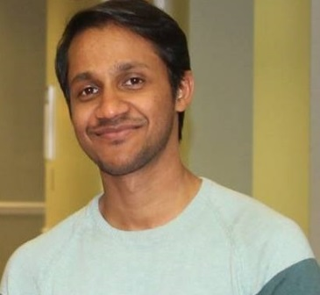
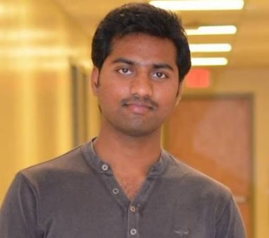
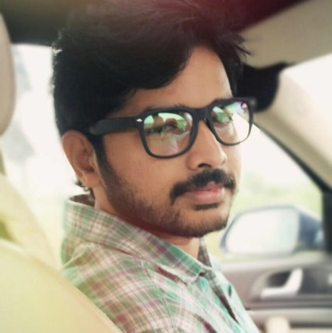
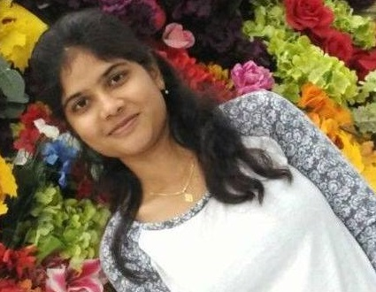
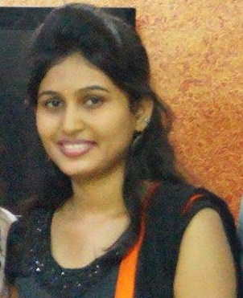
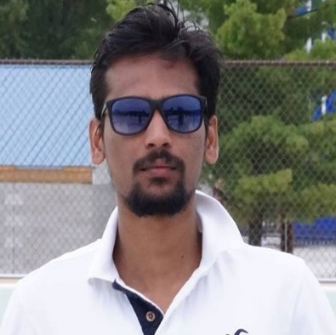
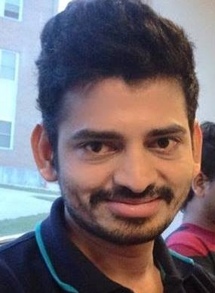
Team members
PRASUNJIT
MANOJ
SRIKANTH
NAVYA
TARUNI
SAIRAM
SAIRAGHAVA
Team 22 - PartyGuard WebServices
68

Slide 69
Team Member Responsibilities
Role | Team Member
Primary Contact | Prasunjit Nayak
Client Management | Manoj Kumar Are
Requirements Management | Srikanth Chippa
Data Management | Taruni Bollu
Issues Management | Navya Bachati
Quality and Testing Management | Sairam Madhavaram
Communications and Documentation Management | Raghava Singamneni
Team 22 - PartyGuard WebServices
69

Slide 70
Client Information
Name : Jacob Stansbury
Email : S516098@mail.nwmissouri.edu
Mission : To provide WebServices to mobile and web clients
to PartyGuard application
Team 22 - PartyGuard WebServices
70

Slide 71
Agenda
Achievements
Features implemented as per standard API practices
Challenges
Current and future works
Cloud Budget
Team 22 - PartyGuard WebServices
71

Slide 72
Core Functionalities Achieved
Total number of API’s completed to support web and mobile clients – 28
User registration and log in with appropriate role
Token based authentication(oauth)
Users can access and edit their profile
Fraternity/Customer registration
Rendering list of fraternities
Team 22 - PartyGuard WebServices
72

Slide 73
Core Functionalities Achieved
Alerts trigger
Claim and resolve alerts
Create events for fraternities
Activate or deactivate the guards- Toggle functionality
Azure cloud integration with mobile and web clients
Team 22 - PartyGuard WebServices
73

Slide 74
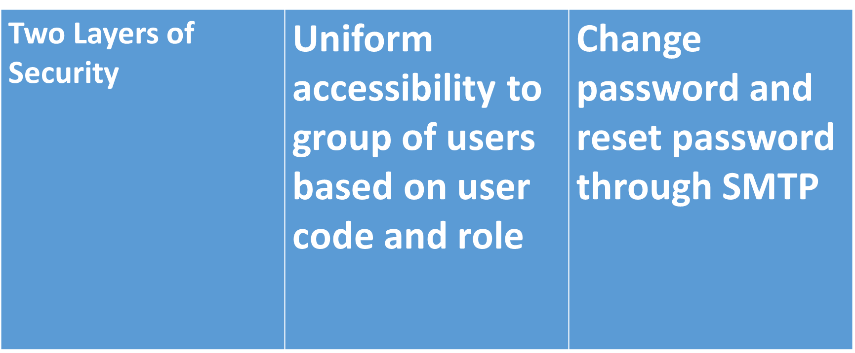
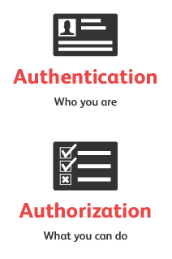
Features Implemented in the API : Security
Team 22 - PartyGuard WebServices
74

Slide 75
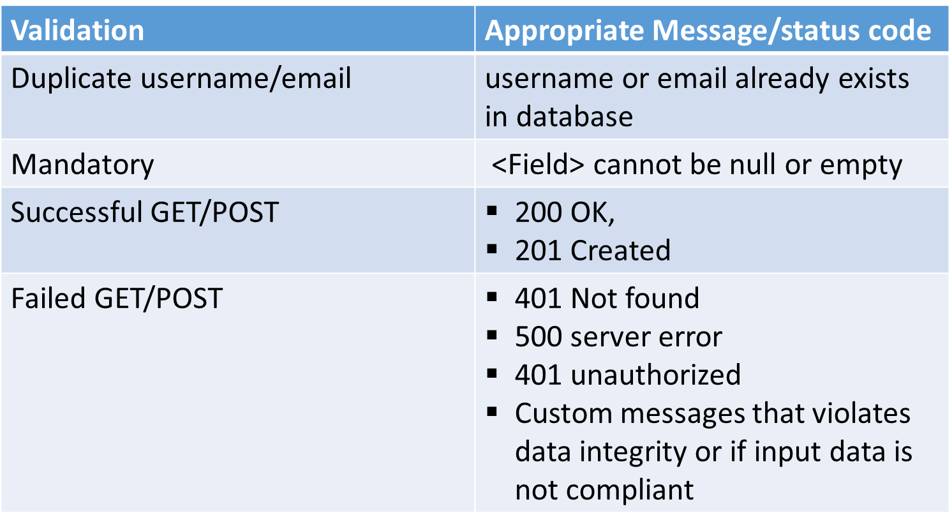
Features Implemented in the API : Validation & Exception Handling
Team 22 - PartyGuard WebServices
75

Slide 76
Challenges faced
Cloud deployment
Integration with web and mobile clients
Database maintenance
Security
Team 22 - PartyGuard WebServices
76

Slide 77
Current and future works
Current work
PUSH Notification
Future work
Deploy the API permanently to Azure (Pay as you go)
Team 22 - PartyGuard WebServices
77

Slide 78
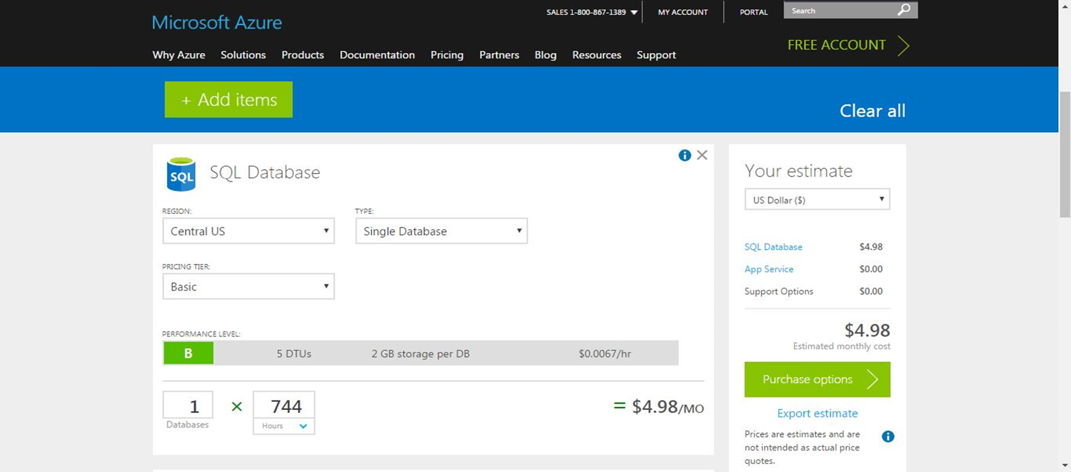
Cloud Budget - SQL
Team 22 - PartyGuard WebServices
78

Slide 79
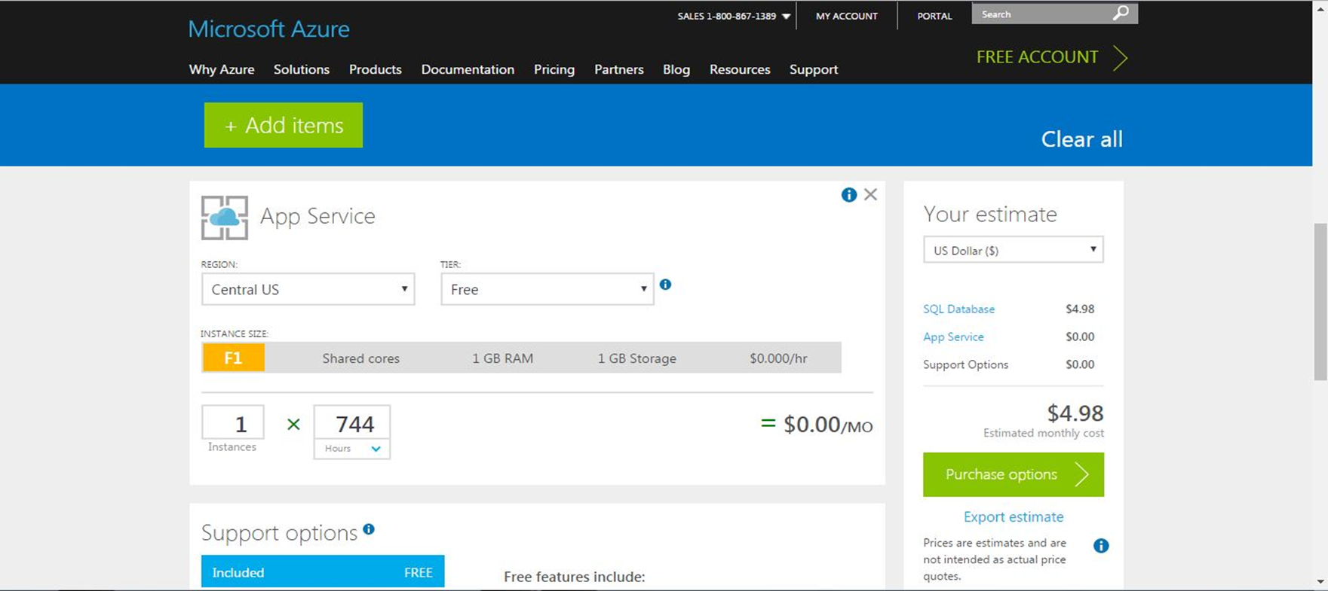
Cloud Budget – App Service
Team 22 - PartyGuard WebServices
79

Slide 80
PartyGuard Demo
Team 22 - PartyGuard WebServices
80

Slide 81
Future Tasks
Write the code for remaining services and integrate.
Try to provide auto login for our application.
Achieve the core functionality features.
81
Team 22 - PartyGuard WebServices

Slide 82
Challenges Faced
Retrieving the alerts and displaying it on the Host/Guard side of the application.
Getting the list of universities from each available location.
Team 22 - PartyGuard WebServices
82

